Slide 1





ETHICAL ANALYSIS AND PROJECTIONS OF
AI IN EDUCATION
Group 8: Gunjan Sharma, Jasmine Gohil, Jenil Shah, Saachi Dholakia, Sneha Ekka

Slide 2

OVERVIEW
AI has the potential to revolutionize education by
Enhancing learning procedures,
Increasing administrative effectiveness,
Improving academic results.
But there are also important ethical issues raised by this technical breakthrough that need to be resolved, such as:
Increased productivity against worries about data privacy,
Issues regarding the use of copyrighted information by AI systems, and
The justice and openness in AI algorithms.
Due to this complicated environment, implementing AI in educational contexts requires careful consideration and moral behavior with the right regulations and policies.

Slide 3



RESEARCH PAPERS
Citation: Pedro, F. et al. (1970)
Artificial Intelligence in education : Challenges and opportunities for Sustainable Development,
DSpace Home. Available at: https://repositorio.minedu.gob.pe/handle/20.500.12799/6533 (Accessed: 23 May 2024).

Slide 4



RESEARCH PAPER ANALYSIS
AI is revolutionizing education by providing fresh approaches to both teaching and learning. But putting AI into practice requires sophisticated infrastructure, which presents difficulties for developing nations. In order to inform suitable policy responses, the publication attempts to educate education policymakers about AI's effects on education
Improving Learning Outcomes: AI can enhance educational equity and quality through personalized learning and better data analytics in educational management.
Preparing Learners: Educational programs must evolve to equip learners with skills for an AI-dominated future.
Challenges and Policy Implications: Identifies six key challenges that need addressing to integrate AI in education effectively.

Slide 5
SECTION I: LEVERAGING AI FOR LEARNING AND EQUITY
AI in Education
Data Analytics in Education Management
SECTION II: PREPARING LEARNERS FOR AN AI FUTURE
Curriculum Development
Computational Thinking Initiatives
AI Capacities Strengthening
SECTION III: CHALLENGES AND POLICY IMPLICATIONS
Policy Development
Data Collection
Research and Ethics

Slide 6
ETHICAL IMPLICATIONS

Slide 7
CONSEQUENTIALIST VIEW ON LLM IN EDUCATION
Potential Benefits
Improved Learning Outcomes: Personalized instruction enhances academic performance and equity.
Increased Efficiency: Streamlines administrative tasks, improving management and freeing up teaching time.
Skill Development: Boosts digital literacy and prepares students for an AI-driven future.
Potential Harms
Privacy Concerns: Extensive data collection raises risks of unauthorized access and misuse.
Educational Inequality: Risk of widening gaps if AI tools aren't accessible to all; equitable access is crucial.
Over-Reliance on AI: May hinder critical thinking; balance with traditional methods is essential.

Slide 8
DEONTOLOGICAL VIEW ON LLMS IN EDUCATION
Moral Principles
Fairness and Transparency: AI algorithms must be unbiased, and decision-making processes must be clear and justifiable.
Privacy Protection: Protect student privacy with explicit consent, anonymization, and data access/deletion rights.
Equitable Access: Ensure all students have equal access to AI technologies to prevent educational inequalities.

Slide 9
ETHICAL IMPLICATIONS FOR STAKEHOLDERS
Policymakers
Enforce regulations for fairness, transparency, and privacy.
Ensure equitable access to AI across schools.
Continuously evaluate and adjust AI policies.
Educators
Balance AI with traditional methods.
Participate in AI training programs.
Maintain transparency with students and parents.
Learners
Understand AI's impact on learning and privacy.
Use AI tools responsibly.
Provide feedback to improve AI technologies.
Comprehensive Approach
Combining both frameworks ensures AI in education maximizes benefits and adheres to essential moral principles, fostering a just and effective educational system.

Slide 10
PROJECTIONS
& UNINTENDED CONSEQUENCES

Slide 11


LIMITATION OF AI IN USING COPYRIGHTED INFORMATION
Limitations on AI Using Copyrighted Information:
Restricted Access to High Quality Content
Development and Training Challenges
Legal and compliance costs
Stifled Innovation
Benefits When AI Can Use Copyrighted Information:
Enhanced Content Quality
Advanced AI Training

Slide 12
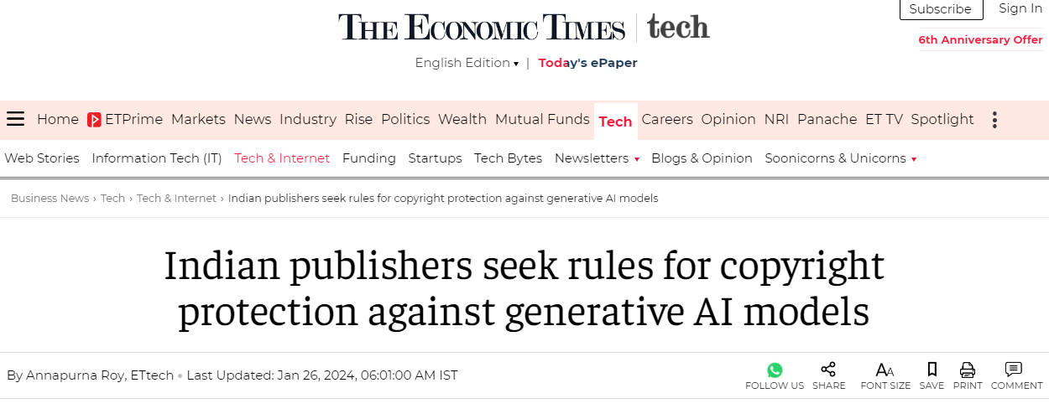
RECENT ARTICLE
According to a recent article in The Economic Times, Indian publishers are seeking stricter rules for copyright protection against generative AI models (The Economic Times, 2024)

Slide 13
DANGER OF ENLARGING THE EDUCATIONAL GAP
Issues
Economic Disparities
Technological Infrastructure
Teacher Training and Support
Strategies for Equitable Access
Public - Private Partnerships
Community and Non-Profit Initiatives
Implications if not implemented
Widening Educational Disparities
Socio-Economic Impact
Reduced Social Mobility

Slide 14
LACK OF HUMAN INTERVENTION COULD AFFECT STUDENTS’ LEARNING CURVE
Issues:
Loss of personal touch & human interaction
Resulting in overreliance on AI leading to shallow learning.
Prevention Strategies:
Balancing AI with Human Involvement/ active Teacher Engagement
Promote self-assessment, digital literacy, and active teacher guidance.
Implications if Ignored:
Isolation and Motivational Decline
Hindered critical skills, increased cheating, and weakened cognition.

Slide 15
COLLECTING AND STORING STUDENT DATA RAISES SIGNIFICANT PRIVACY CONCERNS
Issues:
Privacy Concerns in Student Data Collection and Storage
Ethical Use of Student Data
Strategies for Prevention:
Ensuring Data Security
Implementing Ethical Data Practices
Transparent Data Collection Policies
Implications if not Implemented:
Compromised Student Privacy
Misuse of Student Data
Loss of Trust in Educational Institutions

Slide 16
PROPOSED REGULATIONS

Slide 17

Regulation | Objective | Key Provisions | GDPR Articles + Added Value
Copyright Compliance: AI Training Data Review Board | Ensure lawful use of copyrighted information in AI datasets. | AI Training Data Review Board. Dataset submission and review. Transparency and accountability. | 6, 22 Specific oversight of intellectual property use.
Equitable Access: Funding allocation, tech-equity partnerships | Provide equitable AI access in education. | Funding allocation to underserved schools. Tech-equity partnerships. Standardized AI curriculum. | None specific, Article 5(1)(a) related. Focus on educational equity.

Slide 18
Regulation | Objective | Key Provisions | GDPR Articles + Added Value
Maintaining Human Interaction: Hybrid teaching models | Maintain human interaction in AI education. | Hybrid teaching models. Emotional AI integration. Teacher support programs. | None specific Focus on human interaction in education.
Data Privacy: Content, Anonymyzation, Audits | Protect student data privacy | Explicit consent requirement. Data anonymization standards. Third-party audits. Data access and deletion rights. | 7, 15, 25, 32, 33. Specific focus on student data privacy.

Slide 19
AGENTIC LLM FRAMEWORK

Slide 20
AGENTS IN LLM MODEL
Student Context
Collector
Subject Topic
Specifier
Topic Helper
TASKS CREATOR IN LLM MODEL
Collect Context
Specify Topic
Provide Help

Slide 21
EVALUATE THE EFFECTIVENESS AND ALIGNMENT OF STUDY ASSISTANCE PLANS GENERATED BY AN LLM FOR DIFFERENT EDUCATIONAL NEEDS
Environmental Science
Prompt: Plan a detailed study assistance session covering ecosystems, biodiversity, pollution, and sustainable practices for a high school student.
Narrowly focused on climate change.
Partial alignment
Detailed but limited in scope
Accounting Principles
Prompt: Plan a study session covering basic accounting principles, including examples, for a second-year college student with a learning disability.
Focused on a specific principle with practical examples
Good alignment
Detailed and focused
War in Ukraine
Prompt: Plan a session covering the historical background, key events, major players, and impact on global politics and economy for a second-year college student with a learning disability.
Covered full scope of the prompt.
Good alignment
Broad and detailed

Slide 22

THANK YOU!

